Slide 1


Project name: Pocket Diagnostics Team members: Rohan Bharadwaj, Donavan Burrow, Jacob Newlin, Elijah Rodriguez

Slide 2
Summary of Use
Problem statement:
Technicians in the electronics industry have evolved to servicing customers directly for consumer products, similarly to a plumber or electrician. Often they cannot bring or access bench devices and a suitable substitute is required to complete a job in a timely manner.
Function of the Pocket Diagnostics Device:
Provide a simple, man portable bench device that can evaluate low frequency electrical signals, I2C data signals, SPI data signals, Serial data signals and 16 channel logic signals for troubleshooting on devices that contain such data transfer methods.
Notes:
Jacob

Slide 3
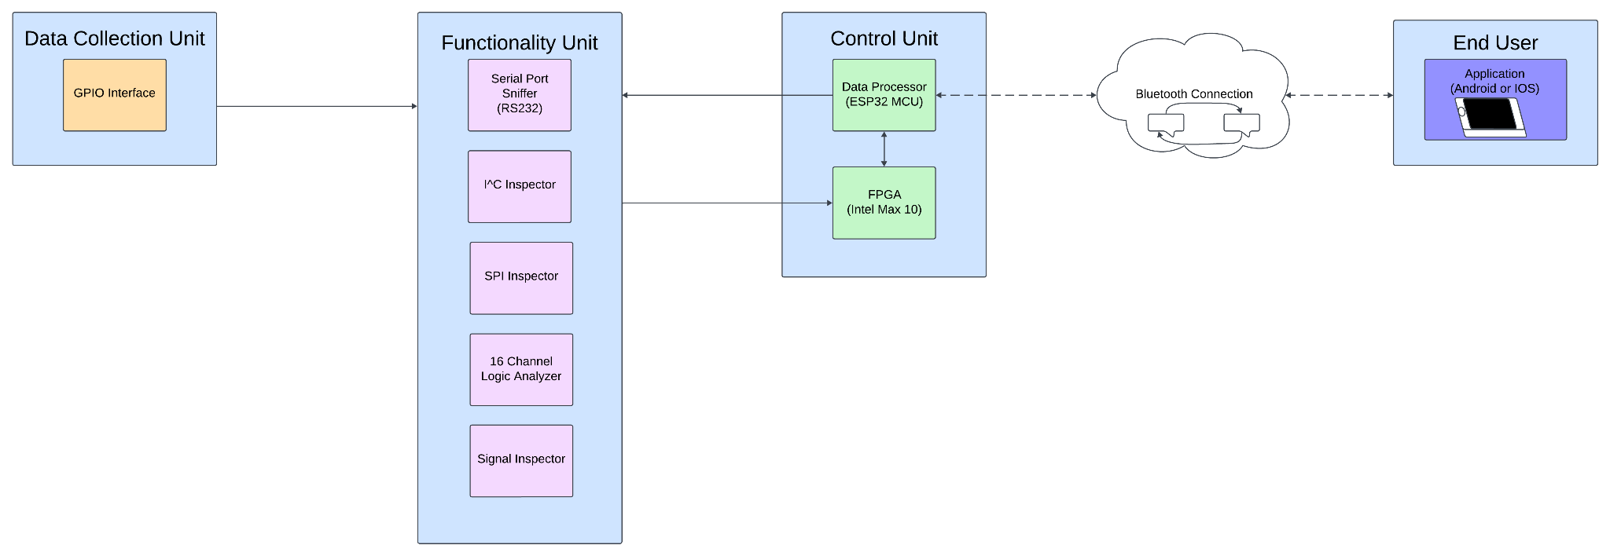
Project description
Develop a small battery-powered instrument that connects to a smartphone that performs the function of the following bench instruments:
Serial Port Sniffer (RS-232, 485, TTL)
I2C Inspection & SPI Inspection
16-channel Logic Analyzer
GPIO Interface, Signal Inspector (simple low-frequency O-Scope).
Notes:
Jacob

Slide 4
Task partition
Donavan: Smartphone App Design
Jacob: Firmware
Elijah: Data Collection and Communication
Rohan: Power Generation and FPGA
Notes:
Rohan

Slide 5
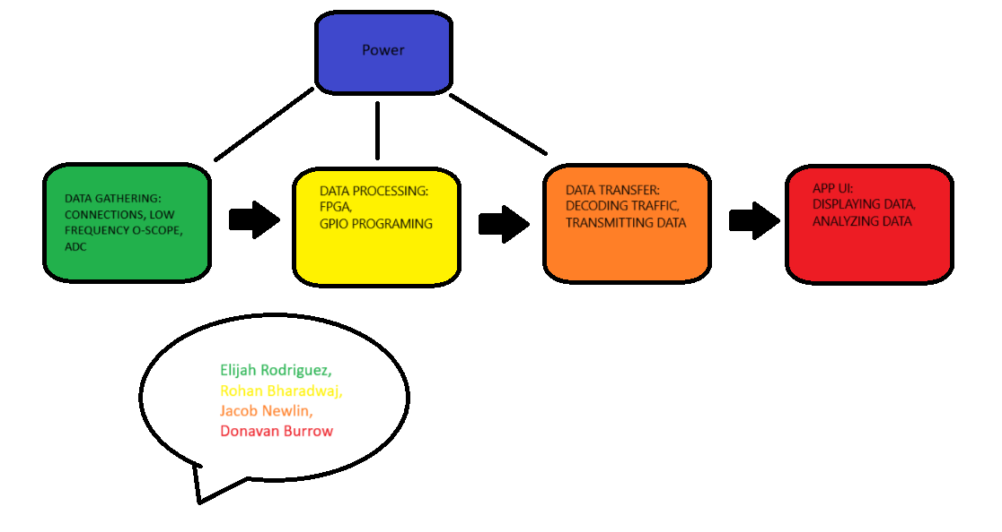
Diagram of Subsystems and Interface
Notes:
Rohan

Slide 6
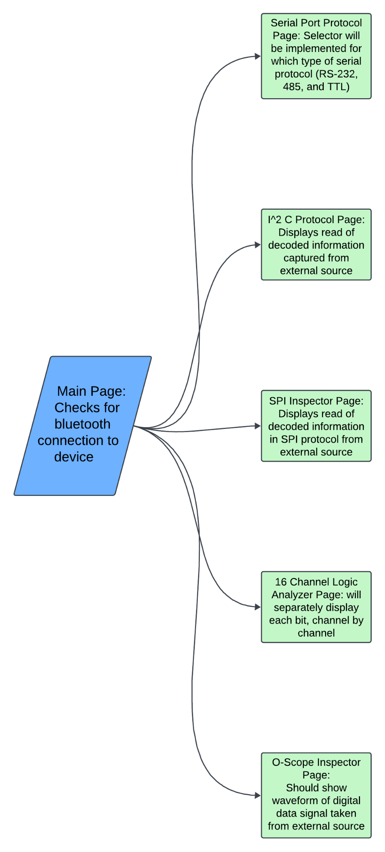
Android/IOS application Subsystem
GUI for user on input and output from device
Communicates via bluetooth to the microcontroller
App will have separate pages for each function
Notes:
Donovan

Slide 7
Power Generation
Power will be provided by a Adafruit: Lithium Ion Polymer battery(3.7V)
The TI BQ25770G chipset will act as a voltage regulator to help manage the charging of the Li-ion battery.
Notes:
Rohan

Slide 8
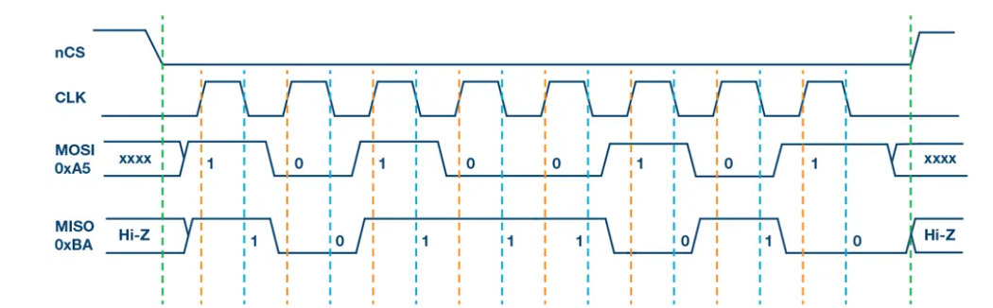
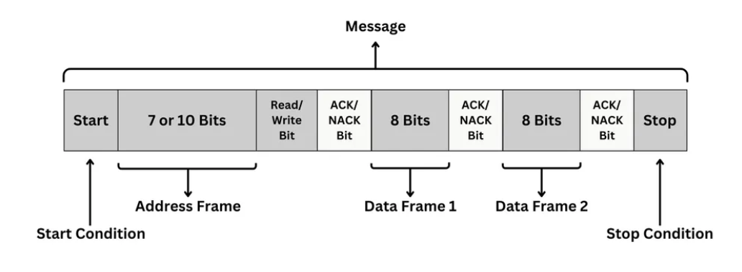
Microcontroller & FPGA
Logic that decodes I2C and SPI protocol
Controlling the clock rates of the units for capturing data
Logic that transmits data to the app via bluetooth
Microcontroller will be programmed in C/C++
FPGA will be programmed in Verilog
Notes:
Jacob & Rohan

Slide 9
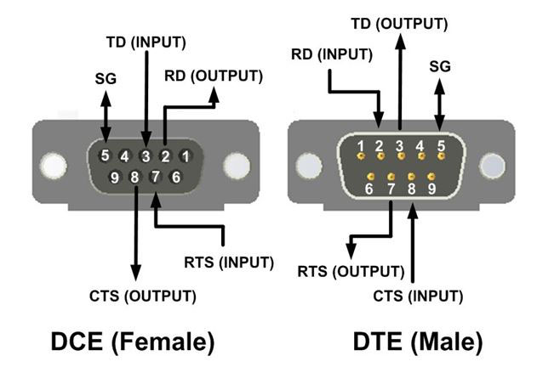
Data Collection and Communication
Capturing serial signals (RS-232, RS-485, TTL)
FTDI Adaptor
Converting analog signal from Oscilloscope to digital.
ADDS1115 ADC
Data captured by the FTDI
and ADC is transmitted to
the microcontroller.
Notes:
Elijah

Slide 10
Subsystem progress in past 1.5 months
Researched communication protocols and individual components.
Worked on subsystem design.
Downloaded software for smartphone app and microcontroller.
Worked on getting accustomed to programming and design software.
Constructed a parts to order list.
 | I2C | SPI | ESP32-WROVER | MAX 10 | Adafruit: Lithium Ion Polymer battery | ADS1115 | FTDI Adaptor
Clock Rate | 100K-5MHz | Up to 100MHz | 80-240MHz | Up to ~200MHz | N/A | 8-860 samples/sec | N/A
Voltage | N/A | N/A | 3.0-3.6V | 2.9-3.5V | 3.7-4.2 V | 2.0-5.5V | N/A
Capacity | N/A | N/A | N/A | N/A | 100 mAh | 0.5mW | N/A
Notes:
Everyone: Jacob Opens

Slide 11
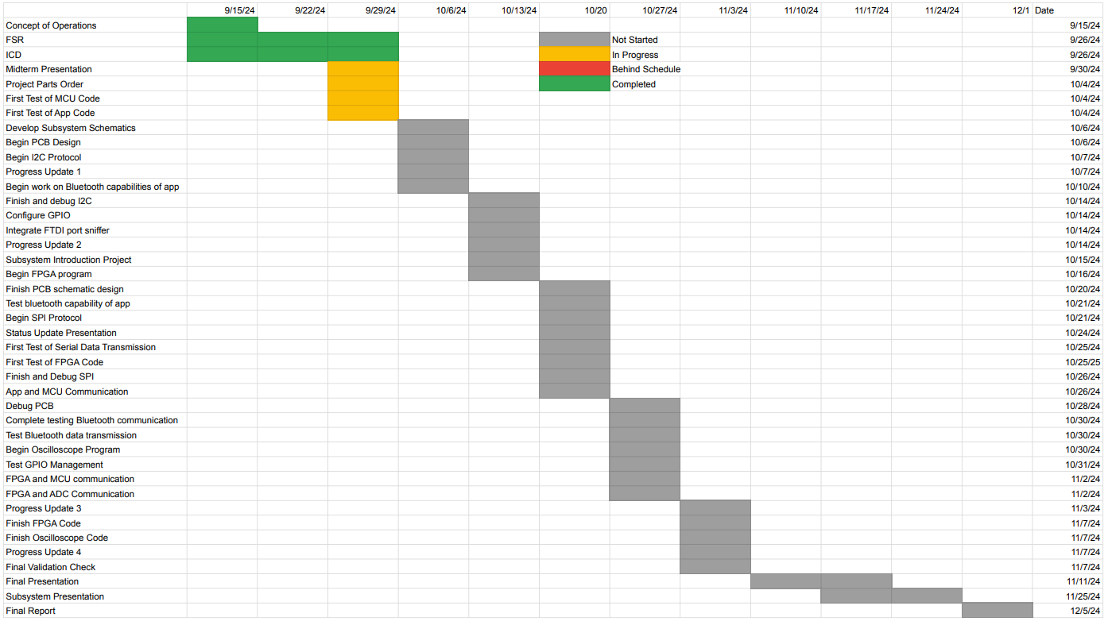
Execution plan
Notes:
Donavan

Slide 12
Validation plan
Task | Specification | Result | Owner
Power Consumption | 4.5 W |  | Rohan
Rechargeable Li-ion battery power supply | 4.5 W for 8 hours |  | Rohan
Input Voltage Level | 3.3 V |  | Rohan
FPGA Signal Processing | Check that signal is processed |  | Rohan
FPGA Logic Analyzer Functionality | Check that captured signal is analyzed by the FPGA |  | Rohan
FPGA and Microcontroller TTL Communication | Check UART1 signals for test data |  | Rohan, Jacob
FPGA and ADC Communication | Check if data is communicated |  | Rohan, Elijah
FPGA SPI Protocol Validation | Check SPI GPIO for test data |  | Rohan, Jacob
Notes:
Elijah 12-14

Slide 13
Validation plan
Task | Specification | Result | Owner
FPGA I2C Validation | Check GPIO for test data |  | Rohan, Jacob
Oscilloscope and Microcontroller Communication | MCU changing O-scope from single capture to continuous mode |  | Donavan
Oscilloscope Noise Performance | As per user manual of TI |  | Donavan
App Bluetooth Communication | Can send and receive information from MCU |  | Donavan
I2C Verification | Check pins 21,22 for test data |  | Jacob
SPI Verification | Check pins 23,19,18 for test data |  | Jacob
MCU Check | Check I2C,SPI,and UART processing |  | Jacob

Slide 14
Validation plan
Task | Specification | Result | Owner
Serial Port Sniffer Verification | Check if FTDI Adapter is working |  | Elijah
Data Transmission | Ensure the data is collected by the ESP 32 |  | Elijah
Data Formatting | Check if data is correct for transmission |  | Elijah

